Slide 1
Elements of a Story

Slide 2
Words to Review
Words we should already know!!!
Setting
Novel
Character
Fiction
Non - Fiction

Slide 3
Vocabulary
Author’s Purpose
Genre
Character
Conflict
Climax
Novel
Narrator
Plot
Point of View
Resolution
Setting
Turing Point
the reason for writing; to inform, persuade, or entertain
classification of a piece of literature
Persons, things or animals taking part in a story
The problem in a story
The main problem is faced; most exciting part!
Long, fictional story
The person telling the story
Pattern of events in a story
The perspective from which a story is told
What happens in the end
Time and Place of a story
When a big change occurs in a story

Slide 4
Character
Persons, things or animals taking part in a story
Traits are the qualities of characters
We can identify traits by words and actions
By what others say about them

Slide 5
Take a look at this website!
http://www.learner.org/interactives/story/characters.html
After viewing this we should have some what of an understanding of our story elements!

Slide 6
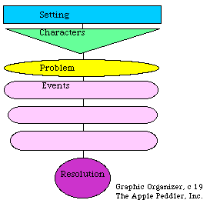
Activity!
Create a story map!

Slide 7
